Slide 1





OPENAURANB

Slide 2
Short Recap
The Objective
Reverse engineer ASUS ROG GL553VE keyboard backlight.
Write driver for using the backlight functionality in Linux.
Implementation Done
Reverse Engineering: 100%
Linux Driver Code: 100%
Presented by R Midhun Suresh (47)

Slide 3









Reverse Engineering
Using wireshark to find out how the device actually works

Slide 4
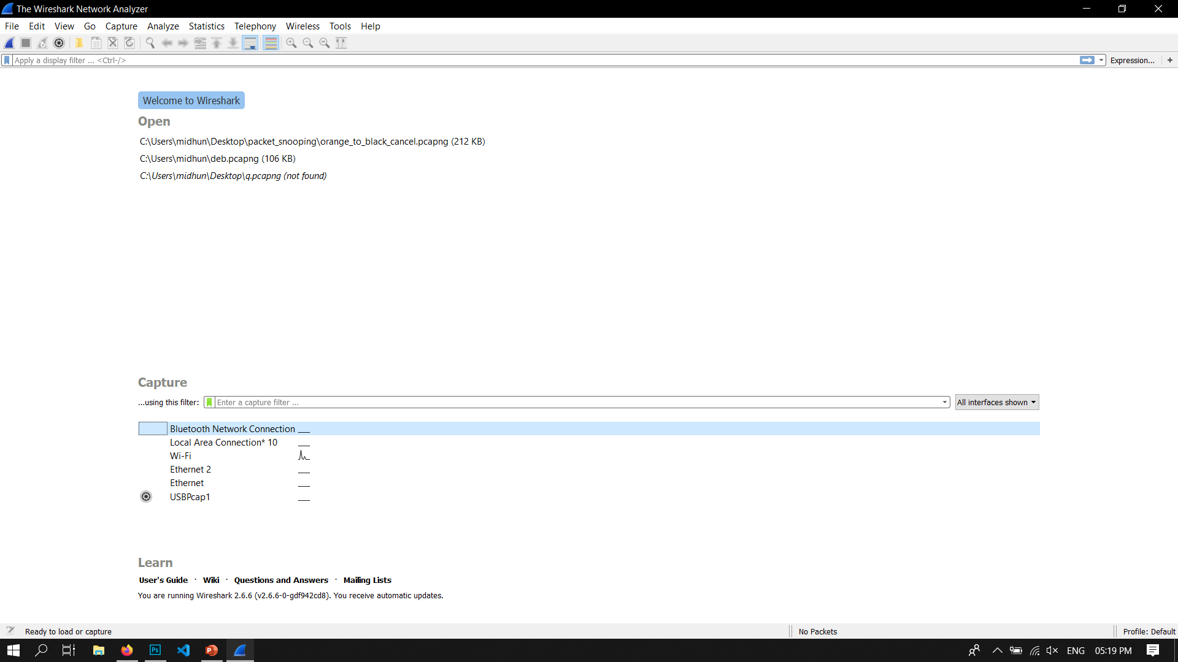
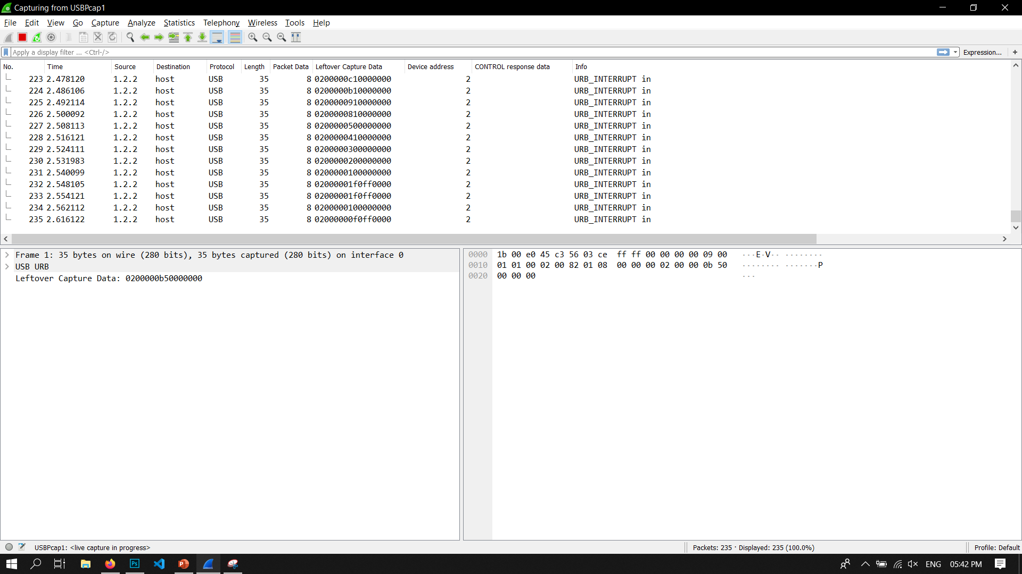
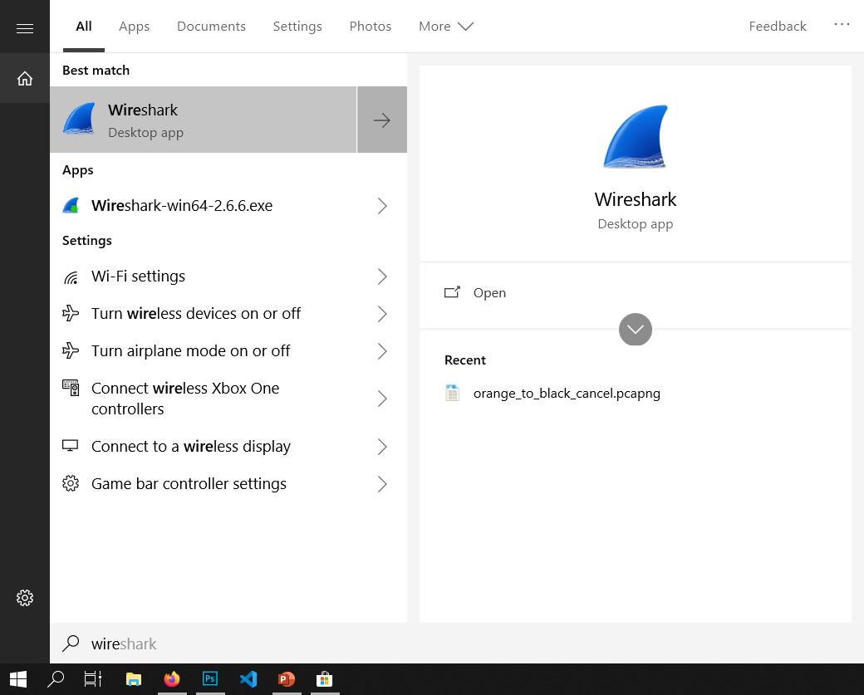
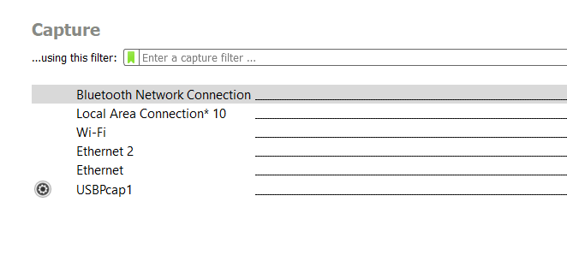
Open up Wireshark And get familiar with the setup
USB PACKETS
Packet Data

Slide 5
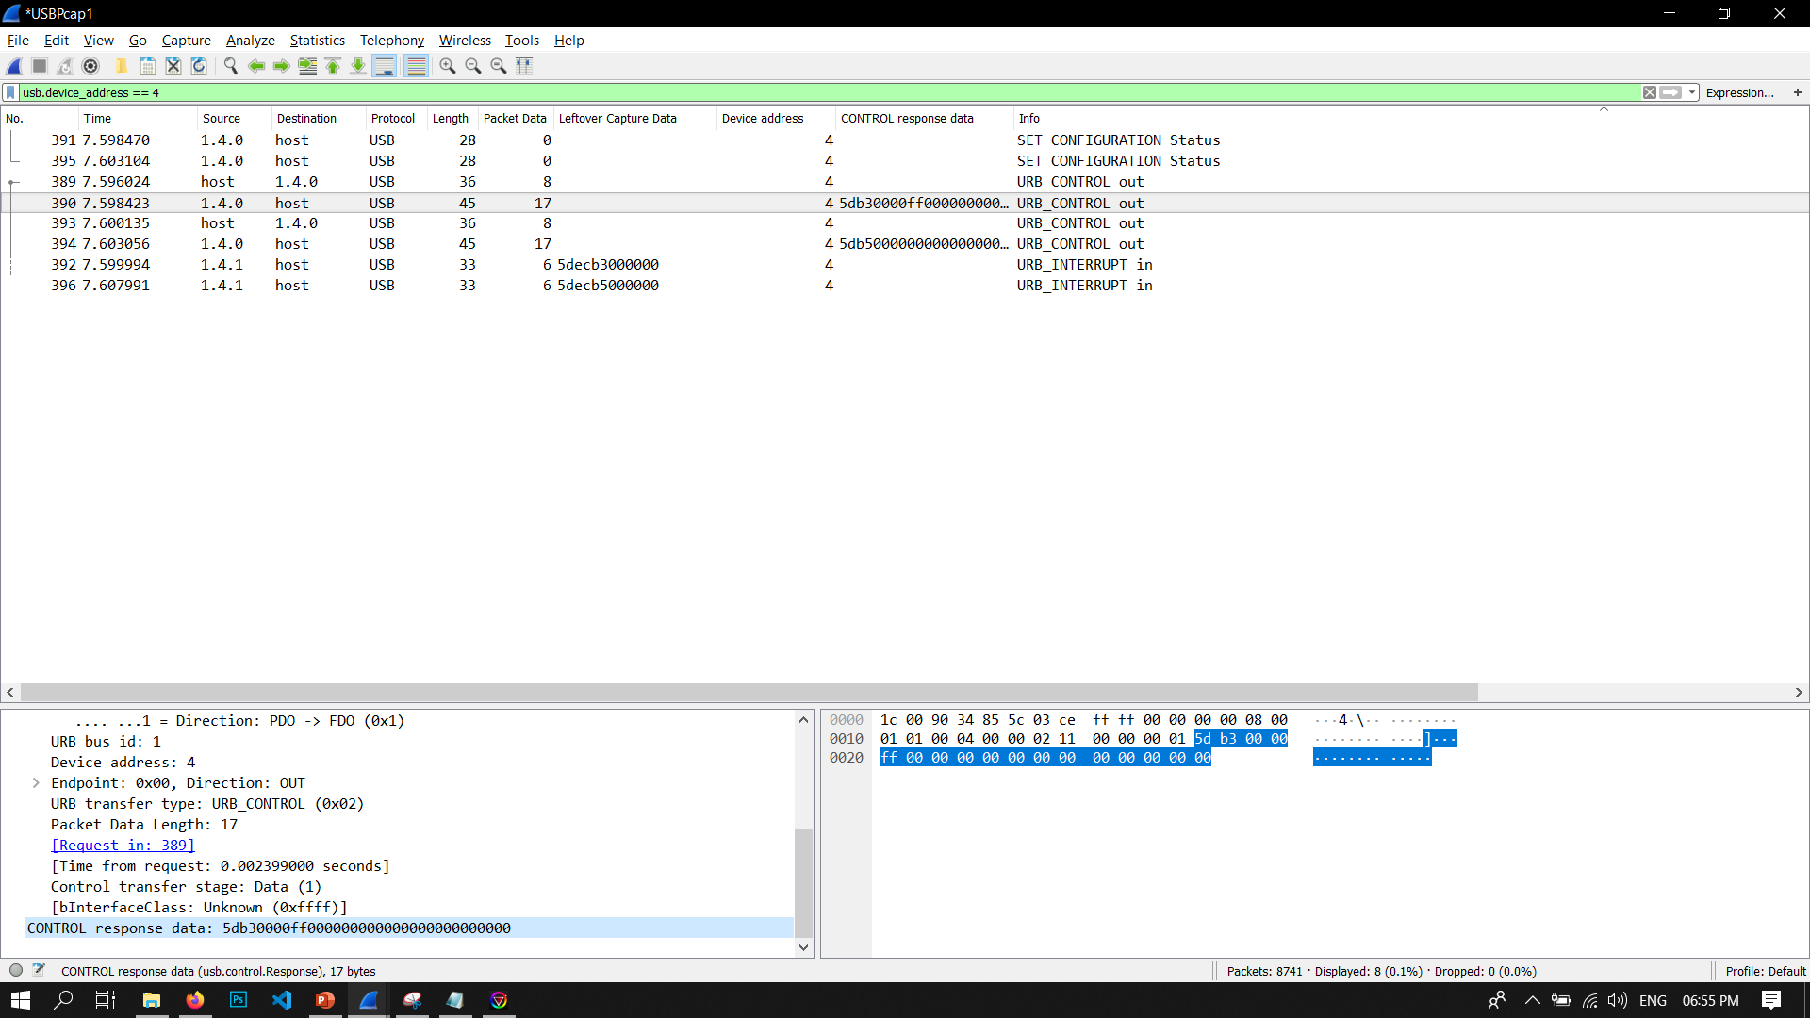
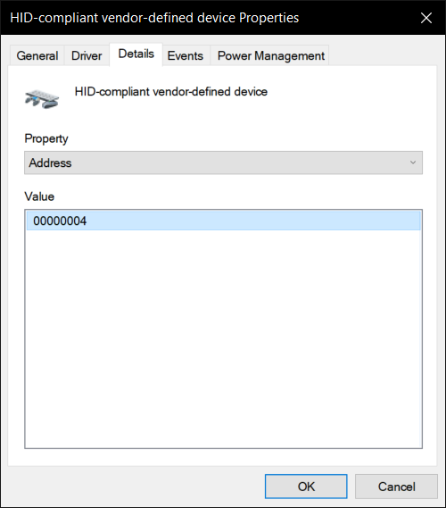
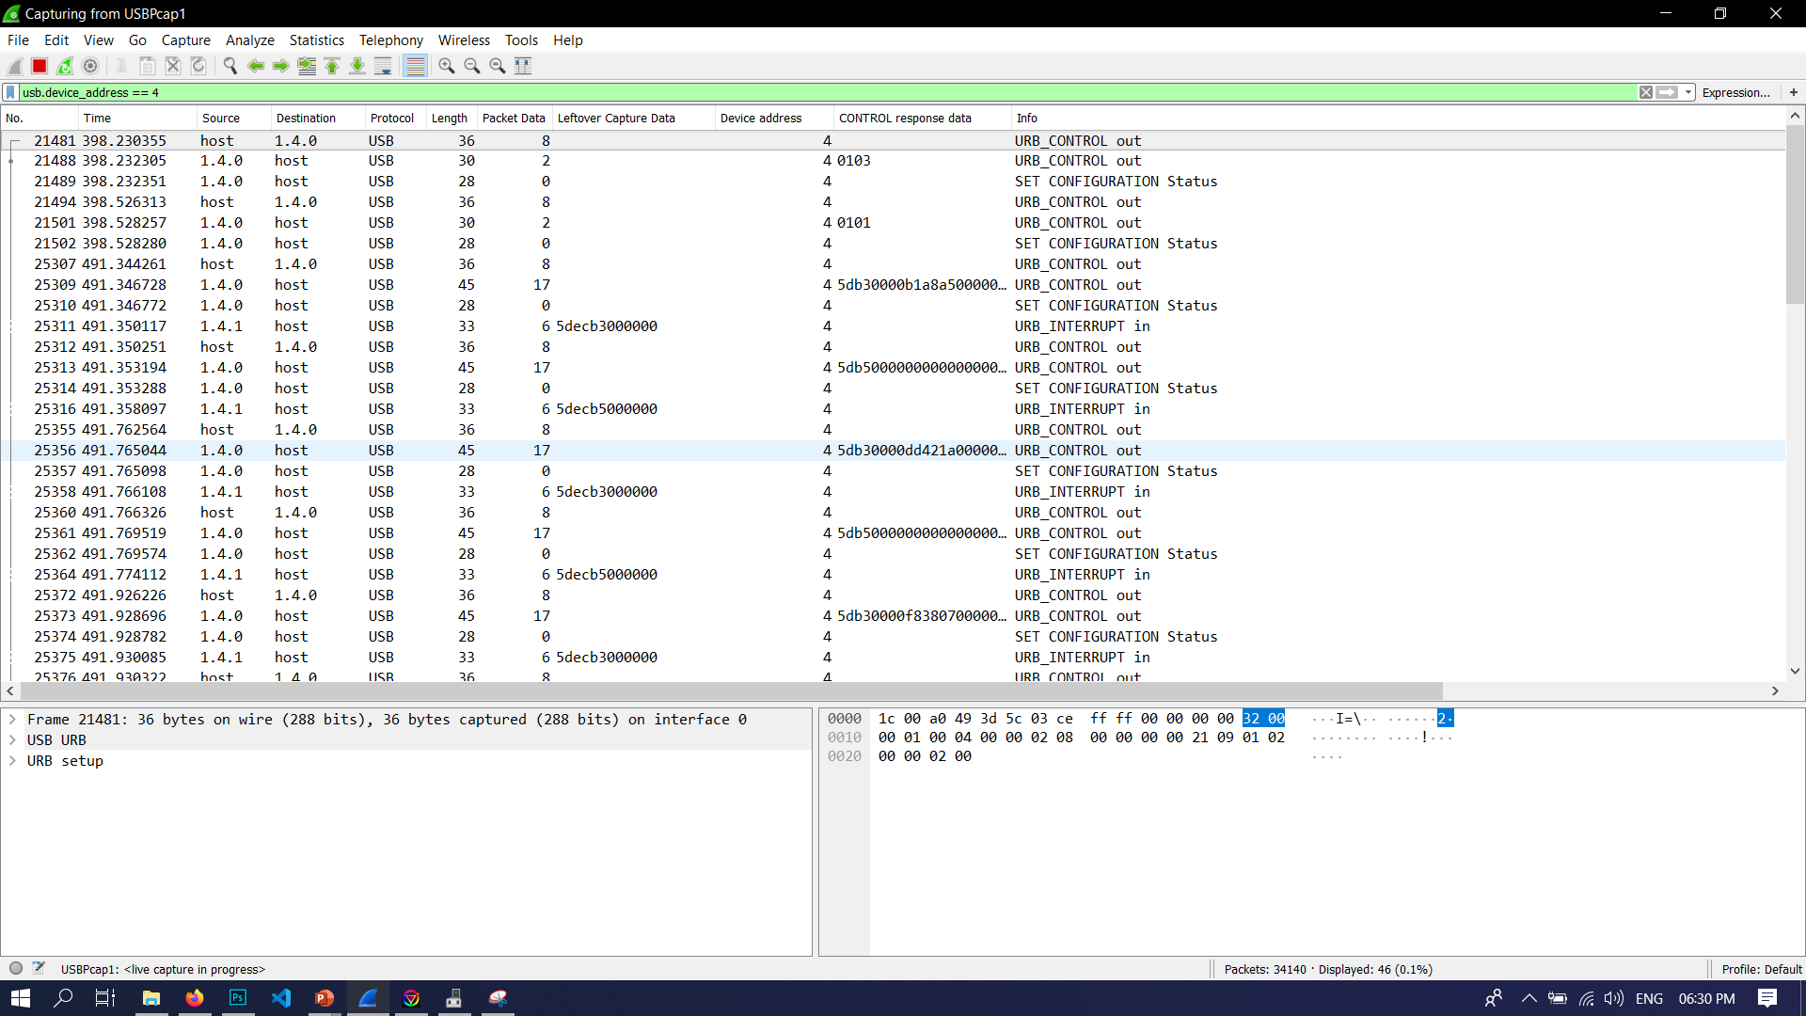
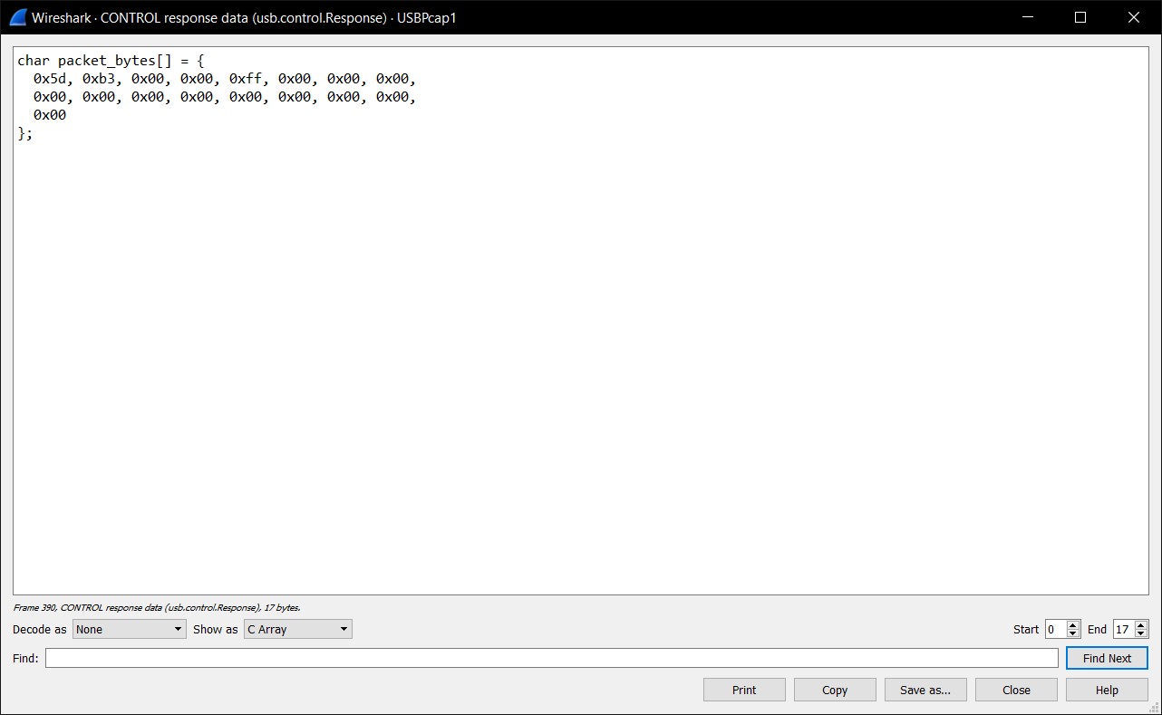
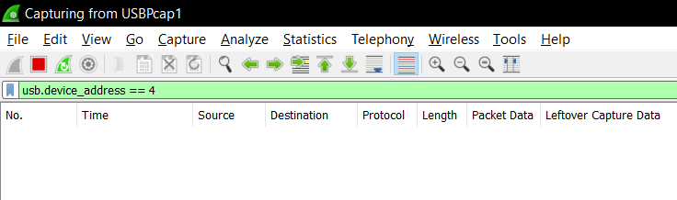
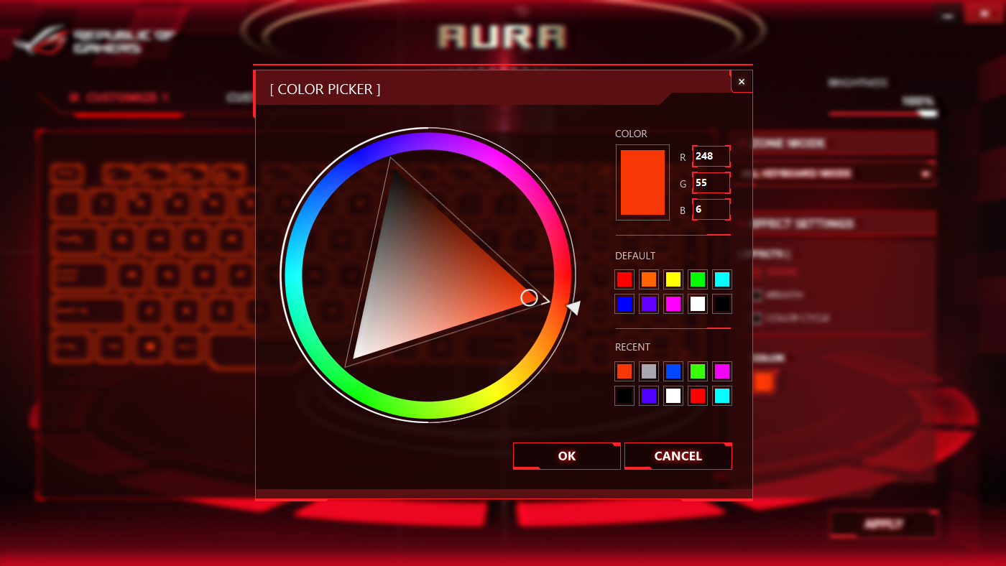
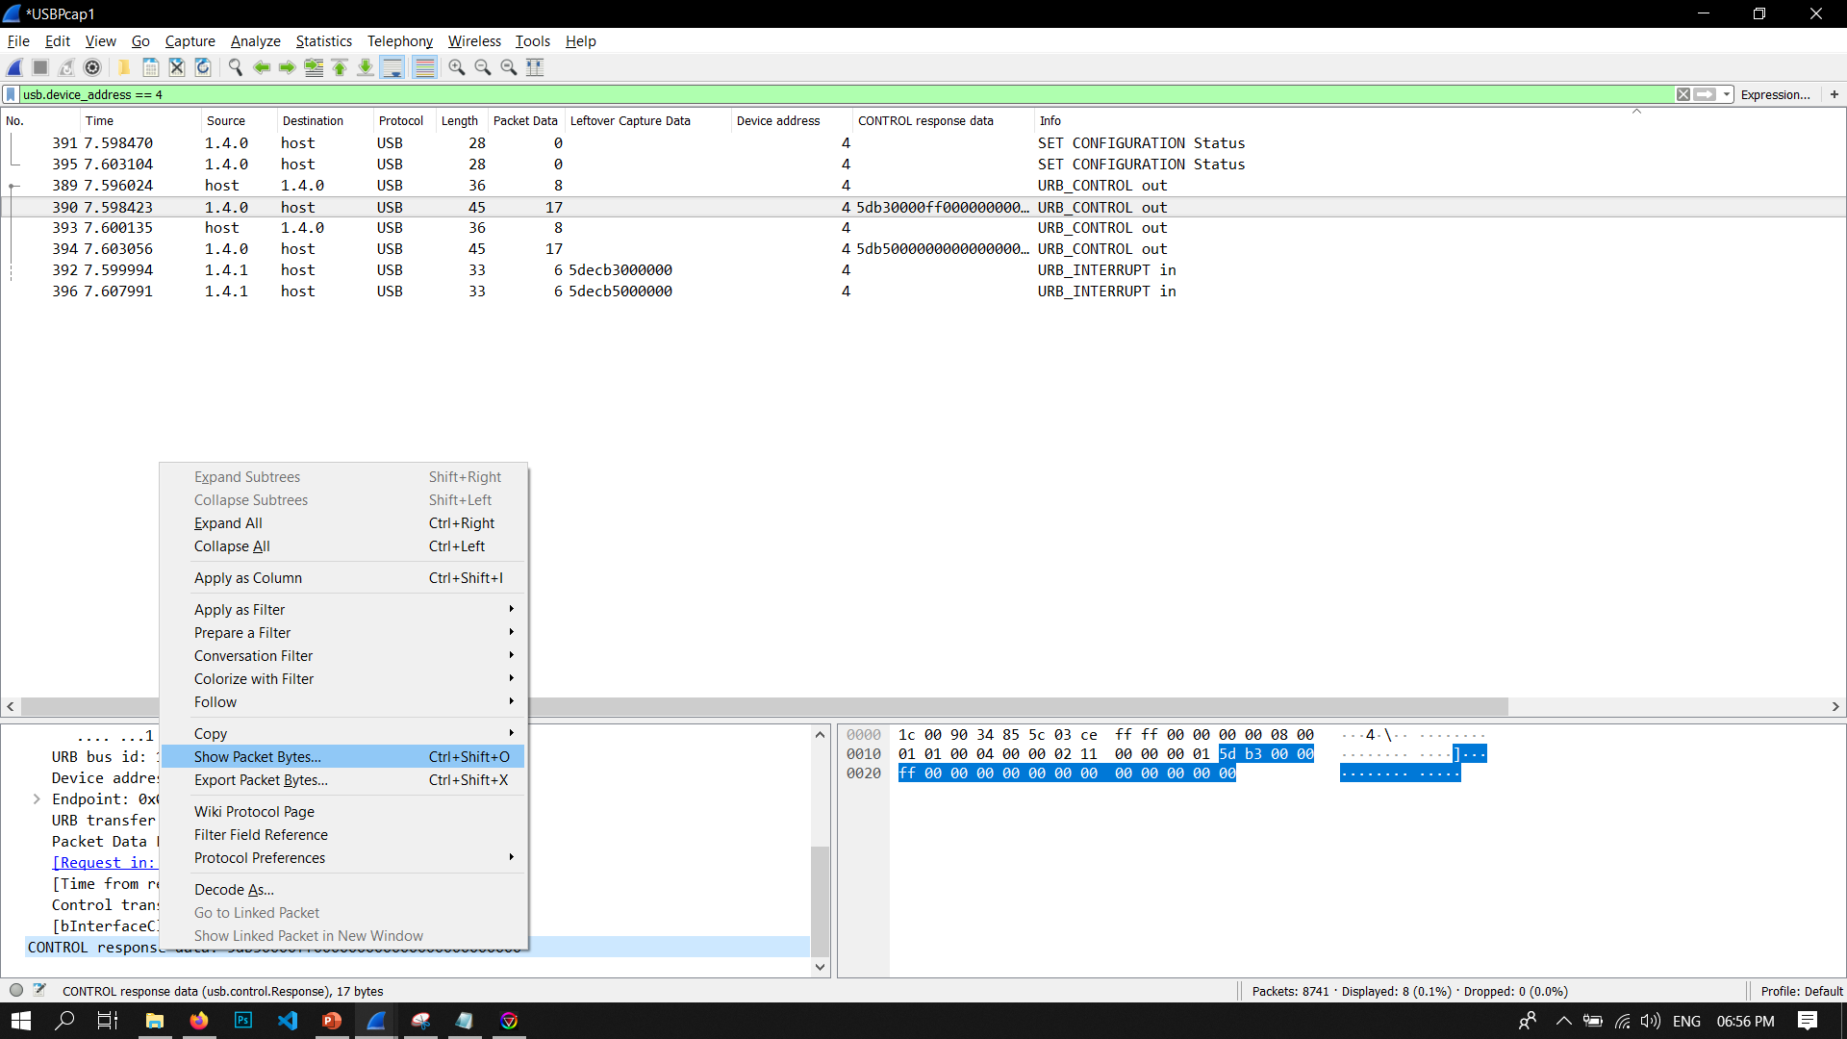
Finding our device
Device address = 4
Packet data
Color code in hex ( here #ff0000)
Filter

Slide 6
Conclusions
To set colour of backlight , first send:
0x5d, 0xb3, 0x00, 0x00, BYTE1, BYTE2, BYTE3,
0x00, 0x00, 0x00, 0x00, 0x00, 0x00, 0x00, 0x00, 0x00, 0x00
Then send :
0x5d, 0xb5, 0x00,0x00, 0x00, 0x00, 0x00,0x00, 0x00, 0x00, 0x00,0x00, 0x00, 0x00, 0x00,0x00, 0x00

Slide 7

CODE
Written in C
Libusb Library
Compiled with GCC
Short ( 250 lines )

Slide 8
Function isROGAura(libusb_device *device)
Input: Pointer to libusb_device
Output: True if the device is ROG aura keyboard, False otherwise
Function sendBytes (char packet[],libusb_device_handle *handle)
Input: Packet array, device handle
Output: Sends the corresponding packet to specified device. If success, prints the number of bytes written otherwise prints the error.
Functions
Function handleDevice(libusb_device *device, uint8_t interfaceNumber)
Input: Pointer to libusb_device, interfaceNumber
Output: Opens the device and sends the required USB packets.

Slide 9
A short Libusb primer
libusb_init()
Initialization/ Deinitialization
libusb_exit()
libusb_get_device_list(libusb_device **list)
Get list of devices
libusb_free_device_list(libusb_device **list)
libusb_open_device_with_vid_pid(uint16_t vendor_id,
uint16_t product_id)
Get device handle

Slide 10
libusb_control_transfer(libusb_device_handle *dev_handle,
uint8_t bmRequestType,
uint8_t bRequest,
uint16_t wValue,
uint16_t wIndex,
unsigned char * data,
uint16_t wLength,
unsigned int timeout
)
Send control transfer

Slide 11


Explore the code further
View the code on at https://github.com/MidhunSureshR/openauranb
( OR)
git clone https://github.com/MidhunSureshR/openauranb.git
Read Libusb documentation at https://libusb.info

Slide 12
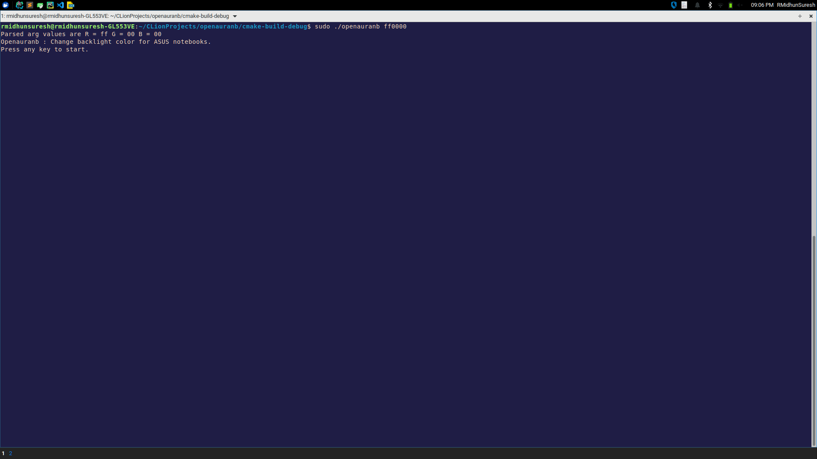
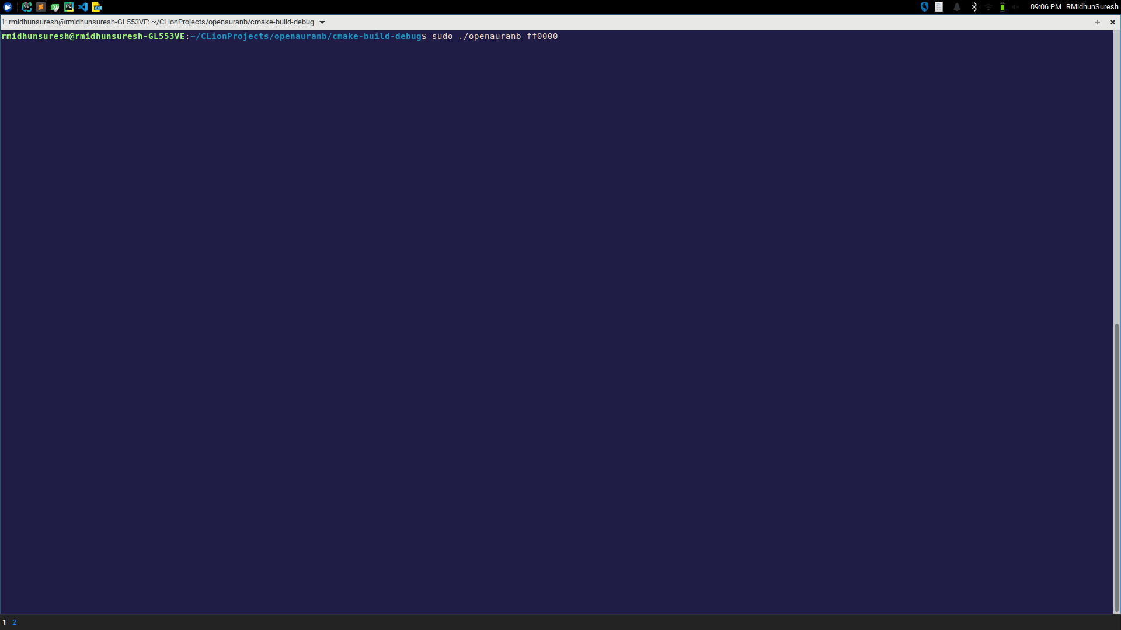
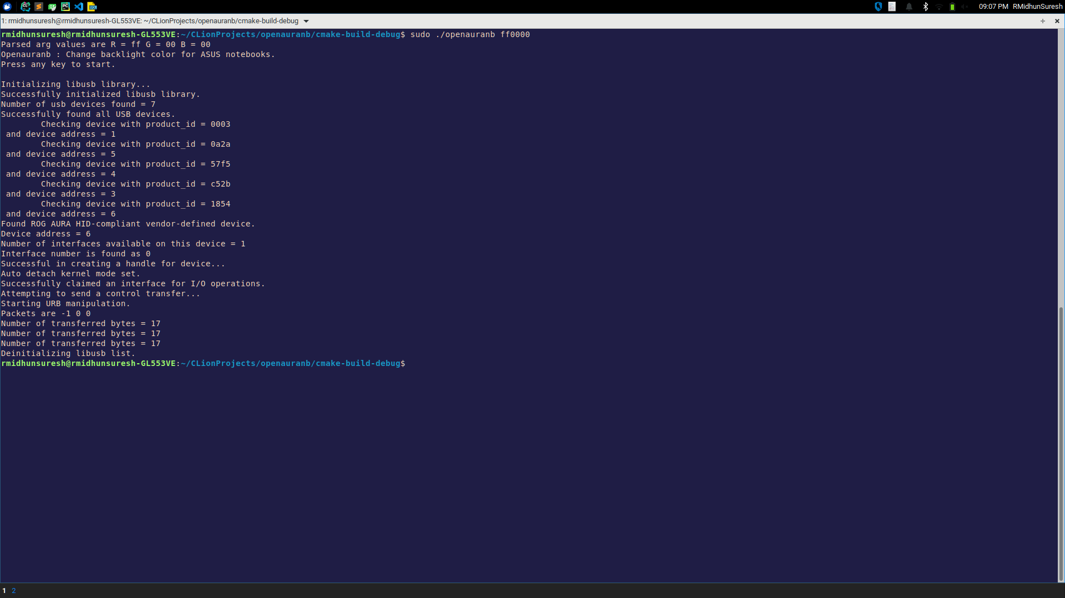
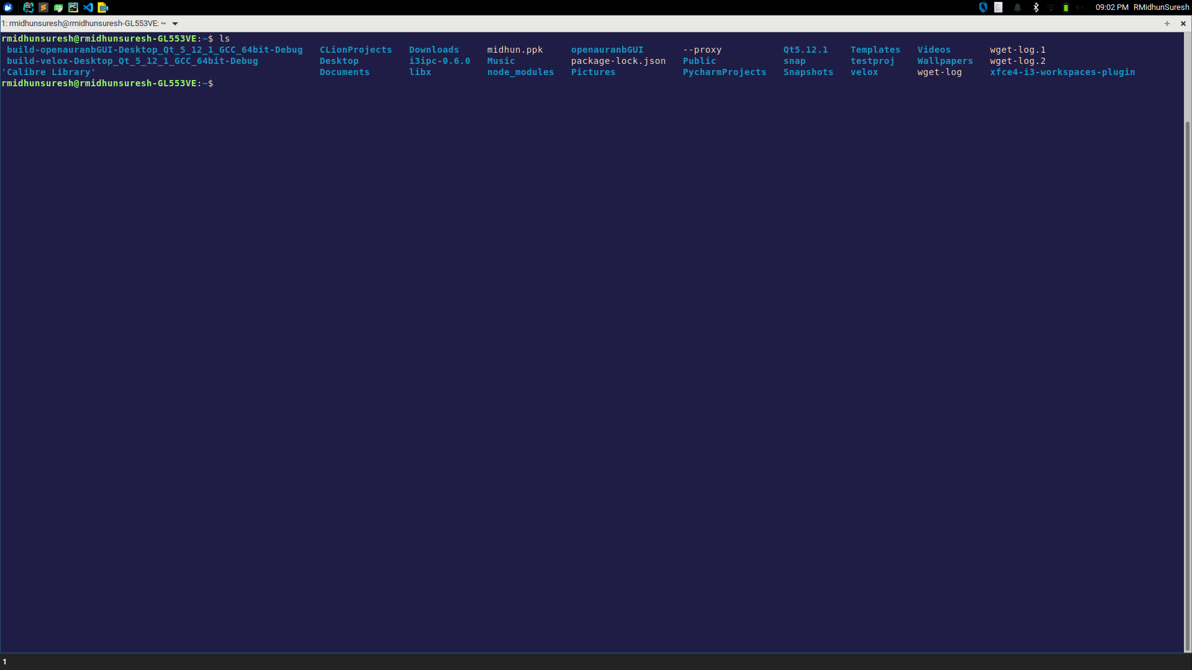
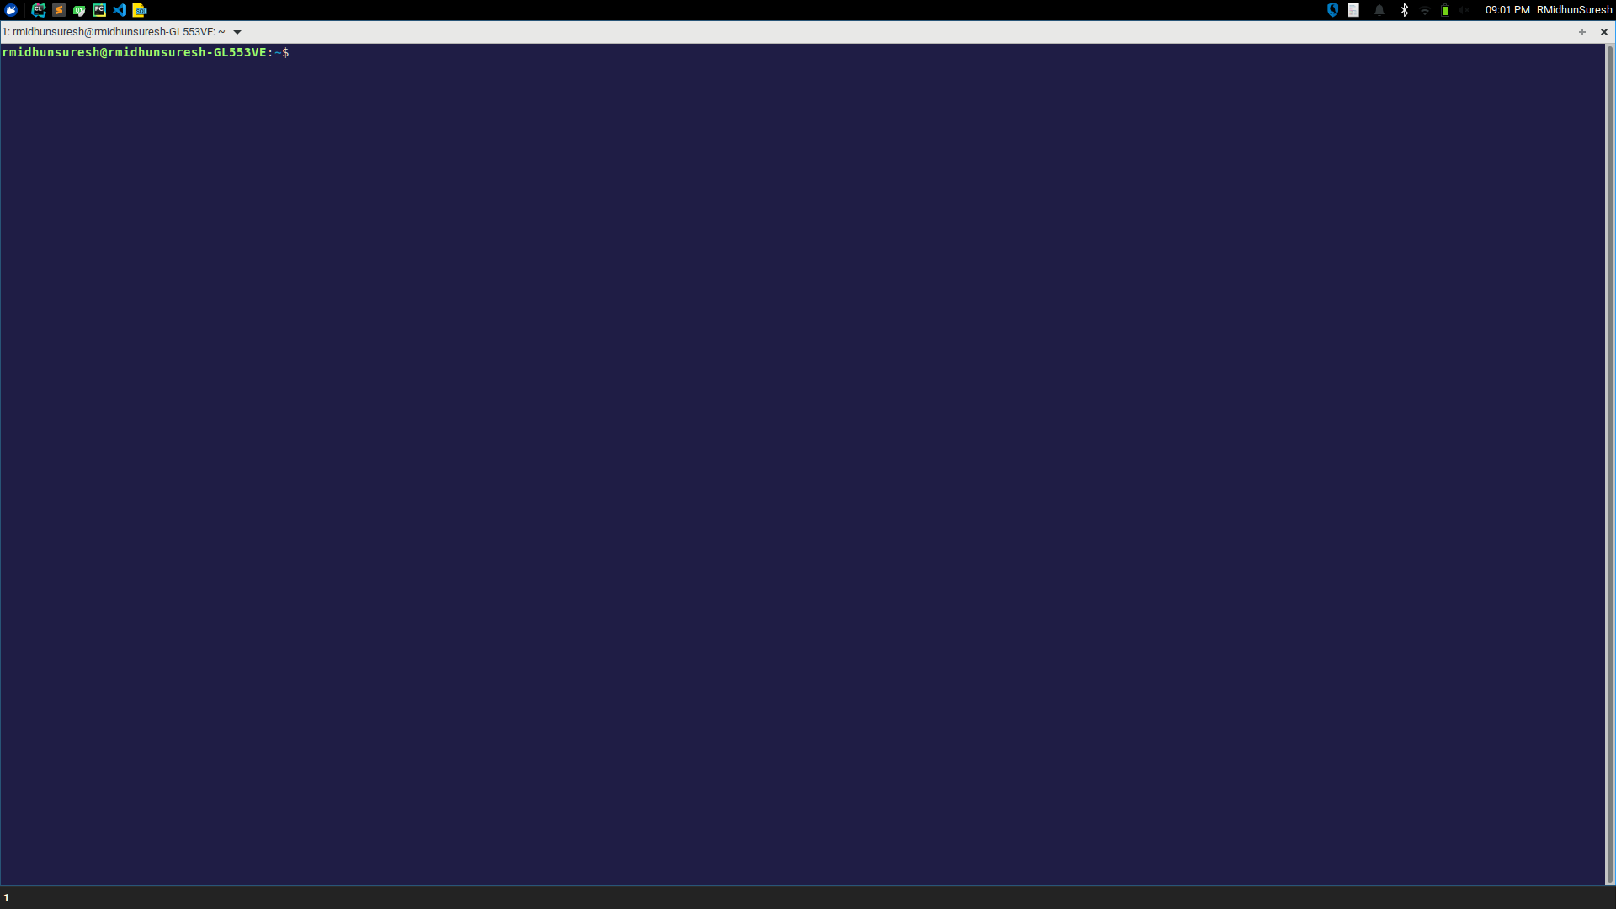

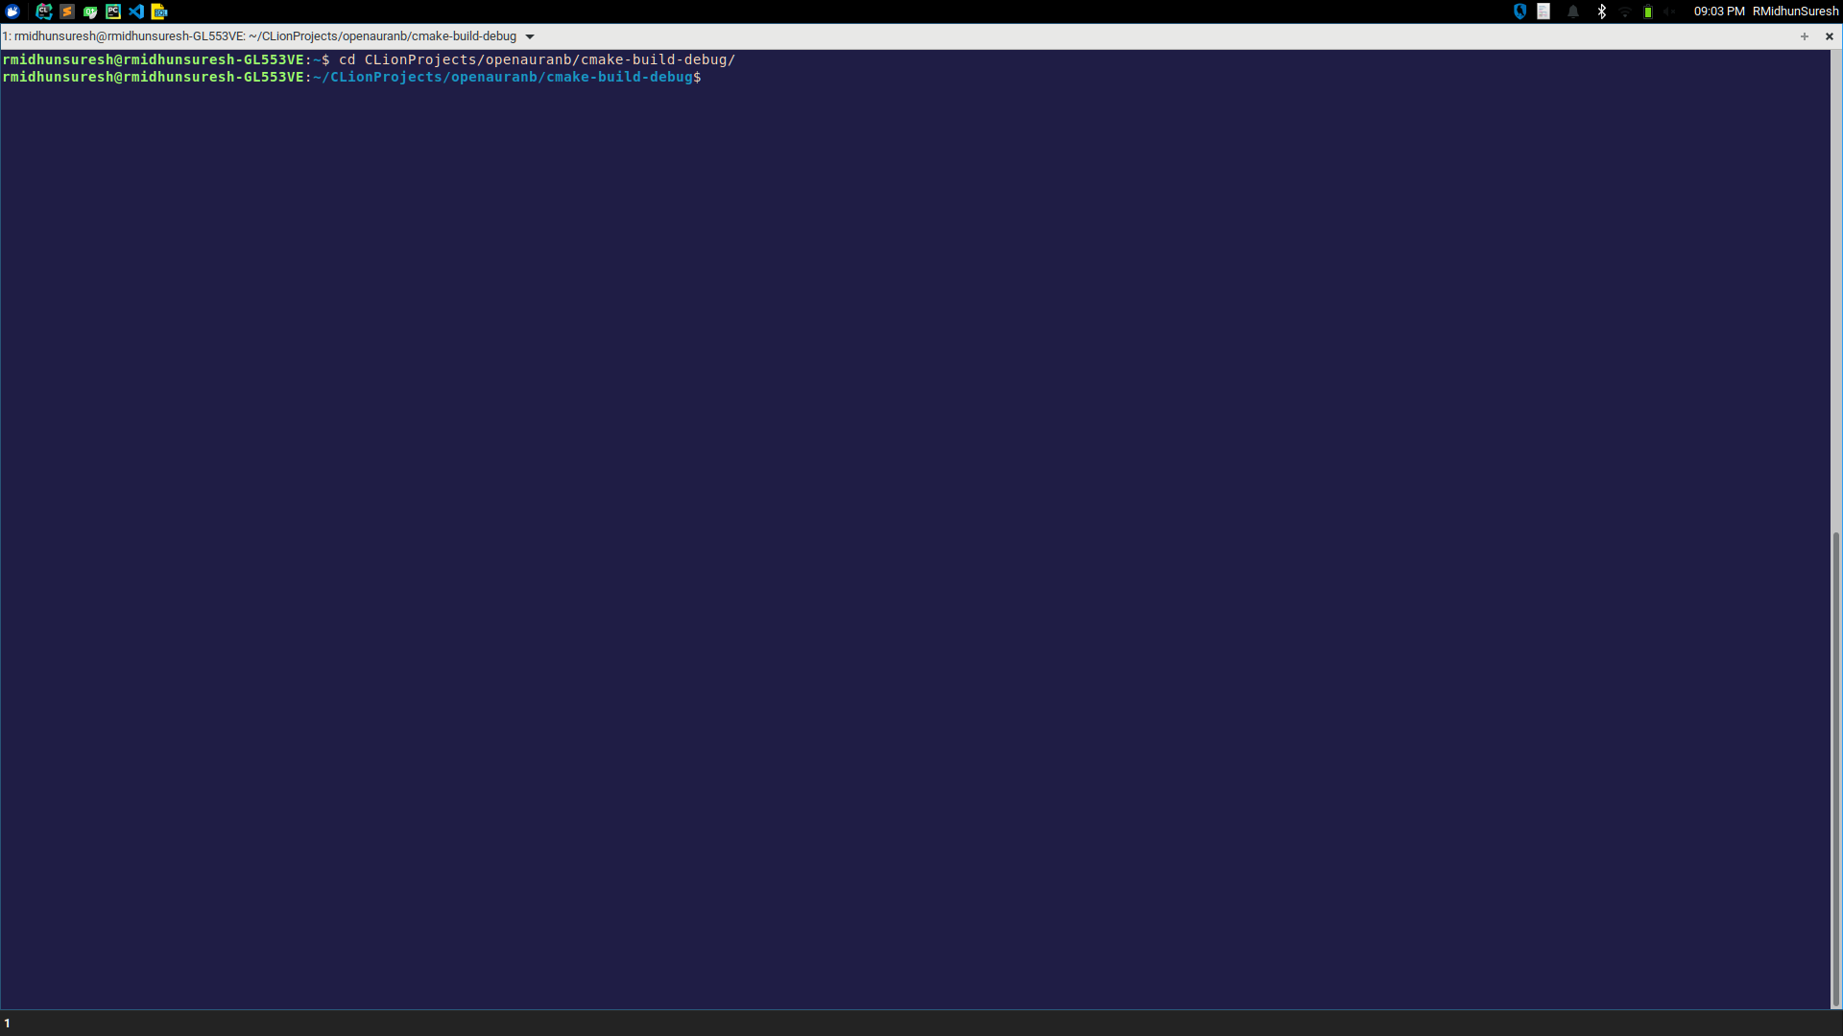
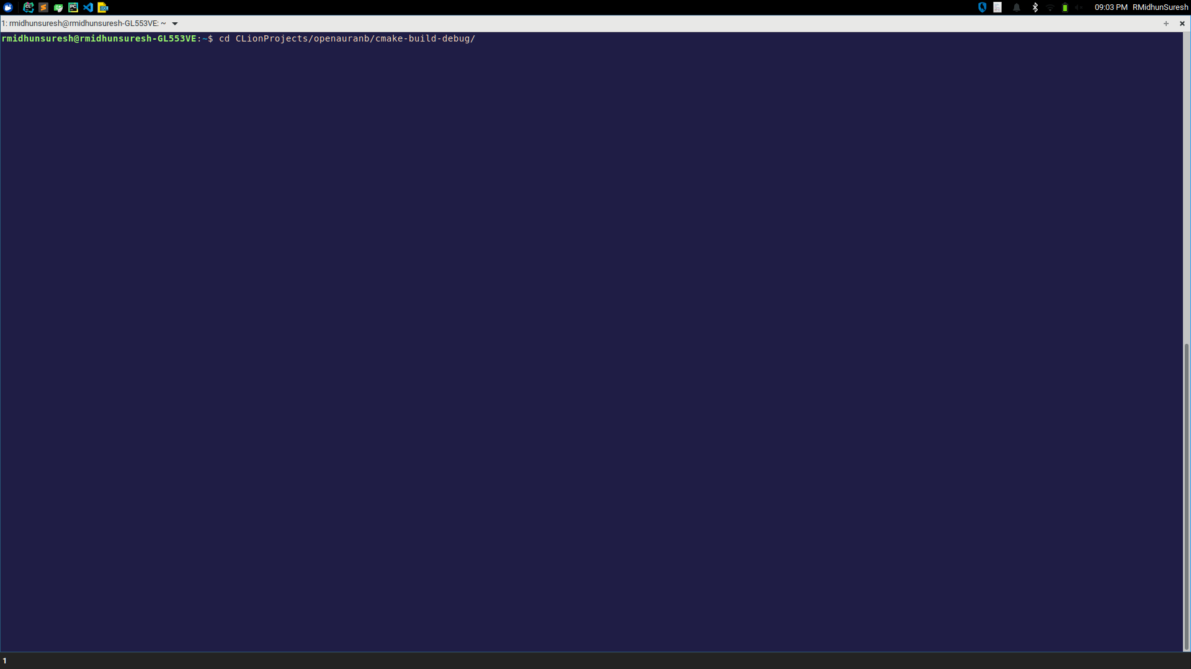
How to run the driver program?
Step 1: Launch a terminal
Step 2: Move into the program directory
Place your screenshot here
Step 3: Run the following command:
sudo ./openauranb colour_in_hex

Slide 13

Thank You!
GROUP 10
R Midhun Suresh

